Slide 1


PHÂN TÍCH ĐỊNH LƯỢNG
NHÓM 16
Giảng viên : HUỲNH NAM

Slide 2


TEAM MEMBERS
PHAN VĂN TOÀN
NGUYỄN CHÍ THANH
NGÔ HOÀI THANH
LƯƠNG NGỌC THẬT
LÝ ANH KHOA
t

Slide 3
PRESENTATION CONTENTS
RFM ANALYSIS
1. What is RFM analysis?
2. Benefits of RFM
3. Customer segments
4. Visualizing RFM data
5. Marketing decisions and messages for each customer segment
t

Slide 4
1
What is RFM analysis?

Slide 5
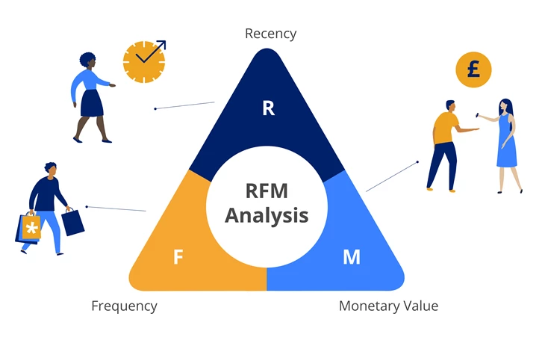
What is RFM analysis?
RFM stands for Recency, Frequency, and Monetary, which is a data analysis method commonly used in marketing and customer management. RFM analysis helps businesses gain a better understanding of customer behavior and enables the development of more effective marketing and customer management strategies.

Slide 6
What is RFM analysis?
Three key elements in RFM analysis:
Recency (R): This is a factor related to the most recent time a customer has conducted a transaction or interacted with a business. It is typically measured in terms of the number of days or months since the last transaction. A customer with low Recency (meaning they recently conducted a transaction) is often considered a more potential customer for continued interaction or shopping.
Frequency (F): This factor assesses the frequency at which a customer conducts transactions or interacts with a business within a specific time frame. It can be calculated by the number of purchases or interactions within that time period. Customers with a high Frequency are usually loyal and valuable to the business.
Monetary (M): This factor measures the total value that a customer has spent within a specific time frame. It includes the total value of purchases or other transactions that the customer has made. Customers with high Monetary value often contribute significant revenue to the business.

Slide 7
Ví Dụ
Let's say you're the manager of an online store that sells clothes. You perform an RFM analysis for your database. You can then categorize customers as follows:
Customer A: Recency: 10 days Frequency: 5 purchases a month Monetary: $500 => This is a VIP client.
Customer B: Recency: 30 days Frequency: 2 purchases a month Monetary: $150 => This is a potential customer to become a VIP if appropriately advertised.
Customer C: Recency: 90 days Frequency: 1 shopping in a month Monetary: $50 => This is an inactive customer who needs to be stimulated to become a more frequent customer.

Slide 8
2
Benefits of RFM

Slide 9
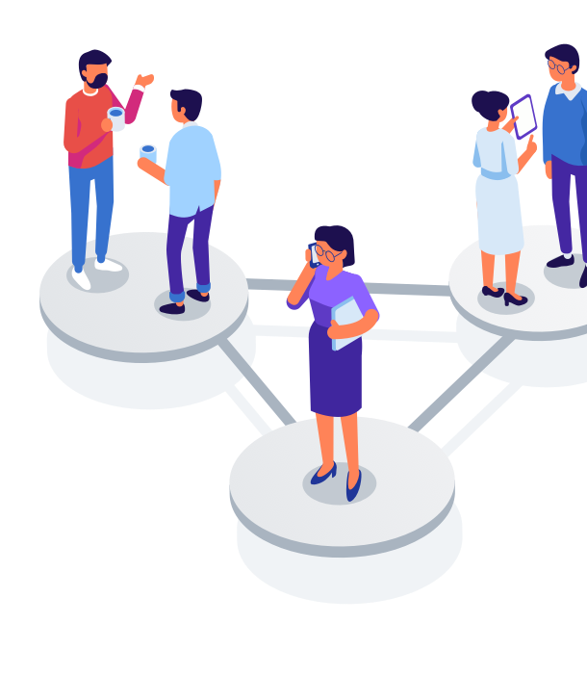
Increase customer retention rates.
Improve response rates from customers.
Boost revenue generated from customers.
It is based on the marketing premise that 80% of your business's revenue comes from 20% of your customers. RFM helps identify customers more likely to respond to promotional campaigns by segmenting them into different categories.
Benefits of RFM analysis

Slide 10
3
Customer Segments

Slide 11
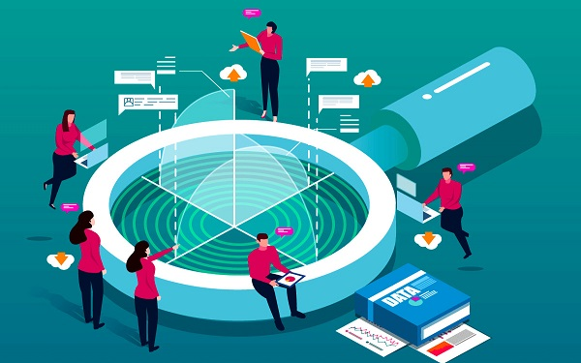

1. How to analyze RFM for effective customer segmentation?
Divide values into intervals on a scale of 1-5
Once you have the RFM values, continue to interval these values and assign them a score on a scale of 1-5 points, with 1 point for the lowest value and 5 points for the highest value.
Example
With the Recognition criterion, new customers who make a purchase within 1 week from now will have a score of 5, while customers who have been 216 days since the last day of purchase will be scored a score of 1. The same applies to Frequency and Monetary.
The RFM value and the RFM score are different. The value is the absolute value of R–F–M for that customer, while the RFM score is a score of 1-5 based on the value after being sorted in an order.

Slide 12
THE TWO MOST COMMON METHODS
Simple interval division
You can assign a Recency score on a 5-point scale with intervals:
• 5 points: New customers have transactions and purchases in 24 hours.
• 4 points: New customers have made transactions and purchases within the last 3 days.
• 3 points: The customer has the last transaction and purchase in the last 30 days.
• 2 points: The customer has the last transaction and purchase within the last 180 days.
• 1 point: The client last traded further than 180 days.
With this method, it is necessary to define the range for each value range and assign a score level to different value ranges. Based on this, you will have 3 score scales R - F - M.

Slide 13


Champions
Loyal Customers
Potential Loyalist
Recent Customers
Promising
Customers Needing Attention
About To sleep
At Risk
Can’t Lose Them
Hibernating
Lost
2. Customer segmentation from RFM analysis

Slide 14
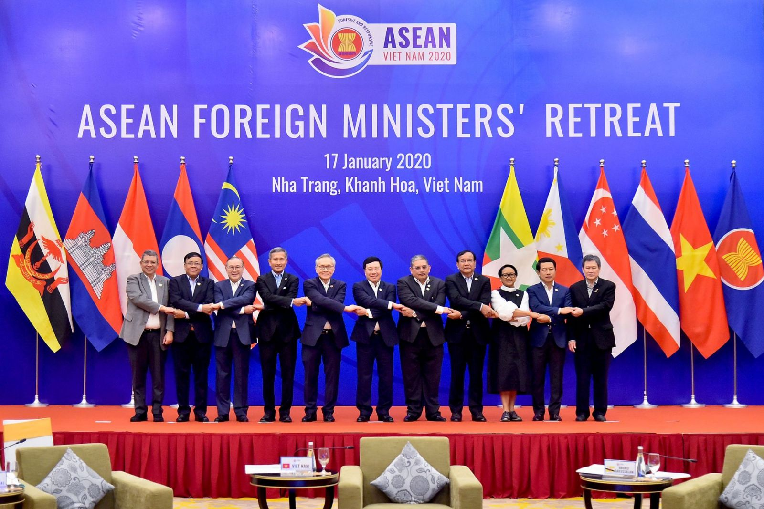

Character
Champions
Are new customers, make the most frequent purchases, and spend the most These customers are loyal, willing to spend generously, and are likely to make another purchase soon.
2. Loyal Customers
Are average spenders – decent but make purchases very often
4. Recent Customers
Are new customers who make their most recent purchases, cart value is small and doesn't buy often
6. Customers Needing Attention
Are customers with a decent purchase frequency and cart value, have not returned to purchase recently
3. Potential Loyalist
Are new customers with recent transactions, spend on average quite well, and have made more than one purchase
5. Promising
As recent buyers, the purchasing power is large but not frequent

Slide 15

11. Lost
As customers who have not returned for a long time, the frequency of purchases and basket value are also very low
10. Hibernating
As customers who have not returned for a long time, purchasing power is weak (low purchase frequency and not high cart value).
7. About To sleep
Customers who have not purchased before for a long time buy goods with low frequency and low cart value
9. Can’t Lose Them
Are customers who have not returned for a long time and used to buy regularly, with a huge cart value.
8. At Risk
Customers who have not returned for a long time and have bought very often with a good average value

Slide 16
4
Visualizing RFM data

Slide 17
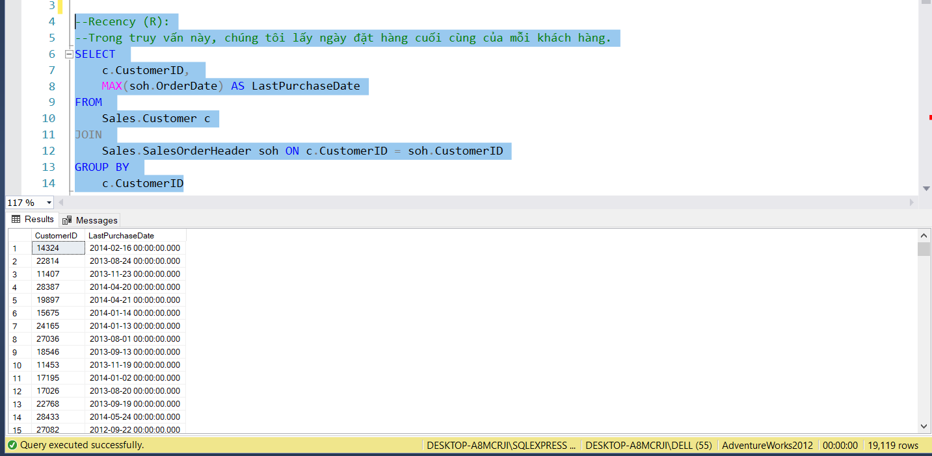
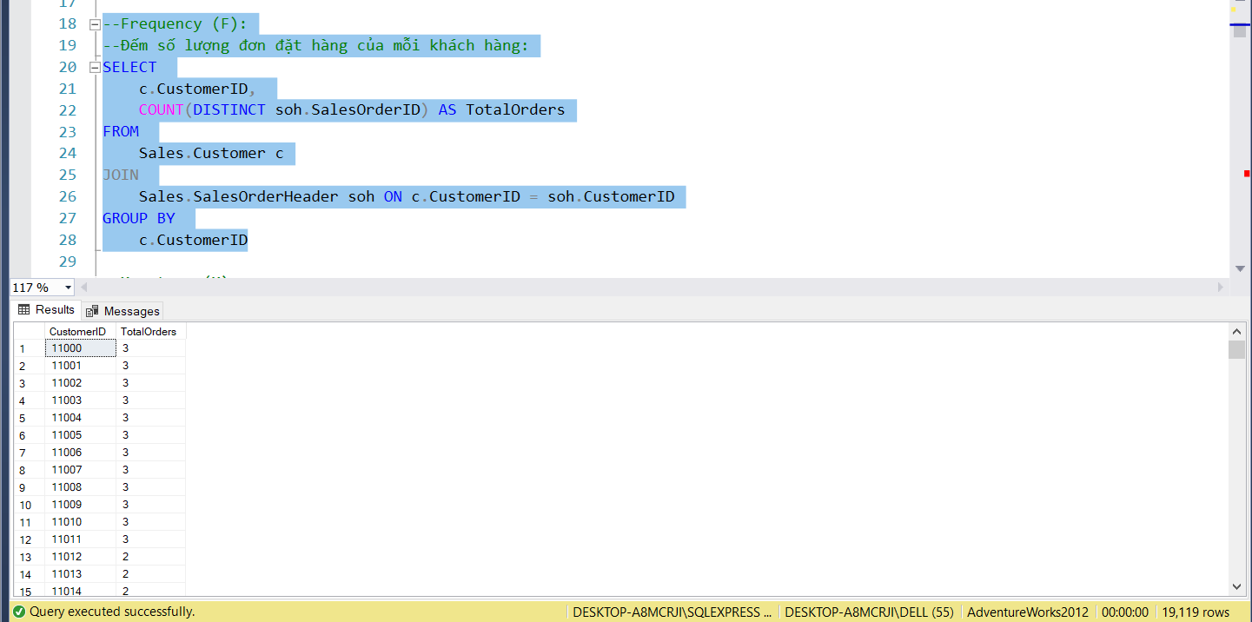
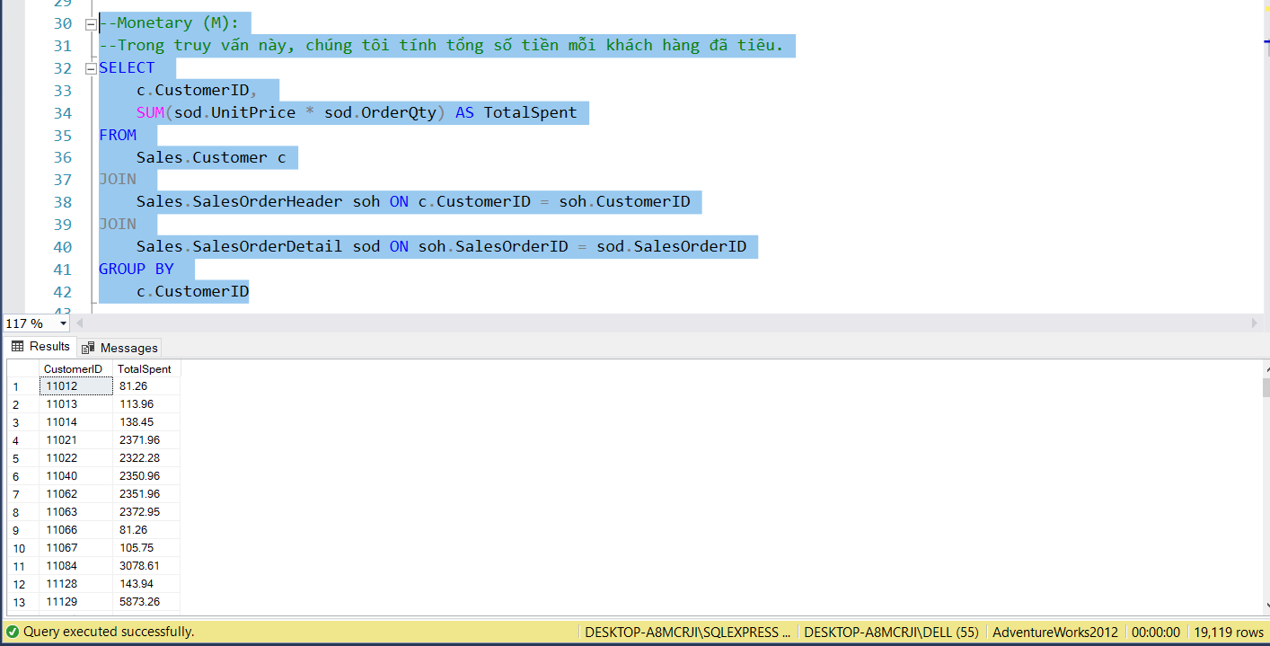

Recency (R)
Frequency (F)
Monetary (M)

Slide 18
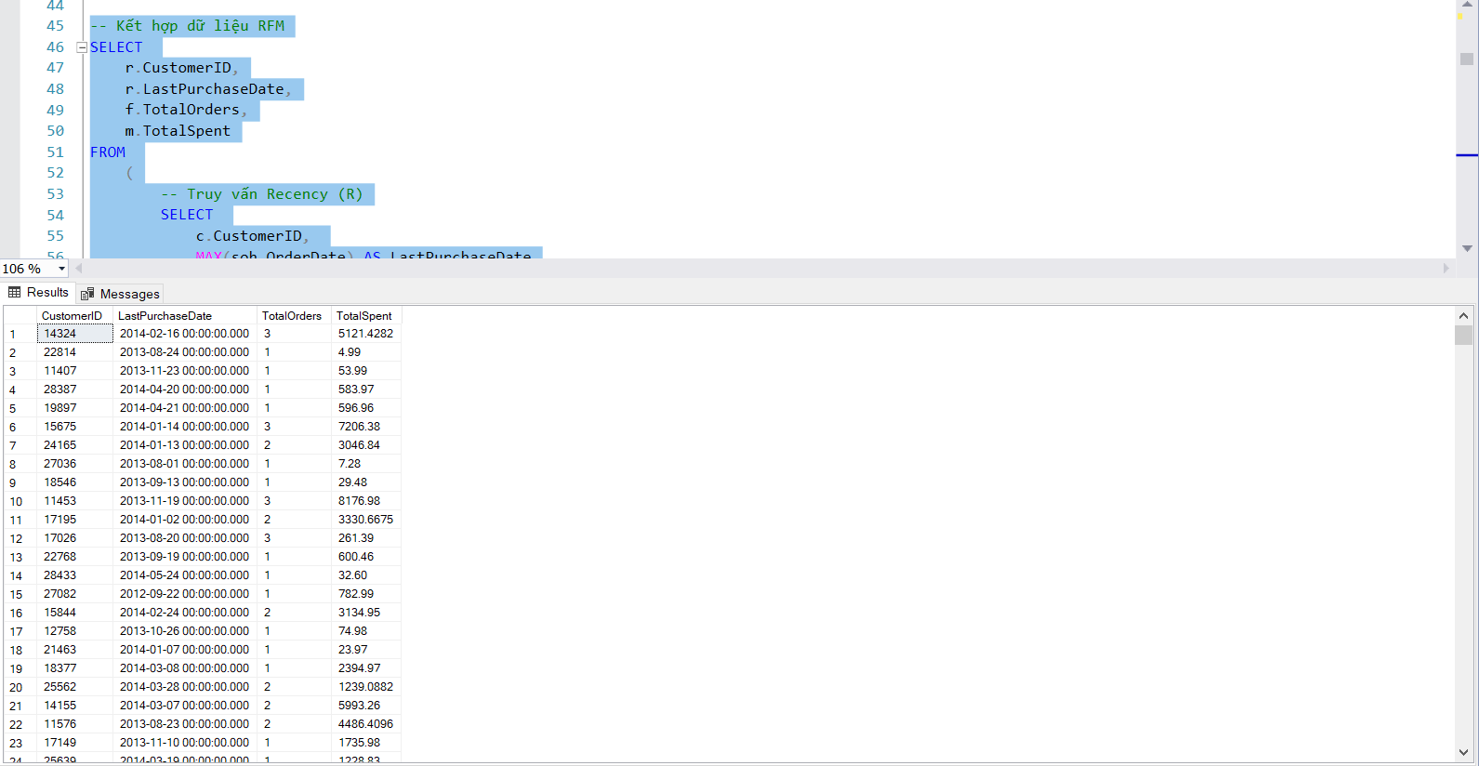
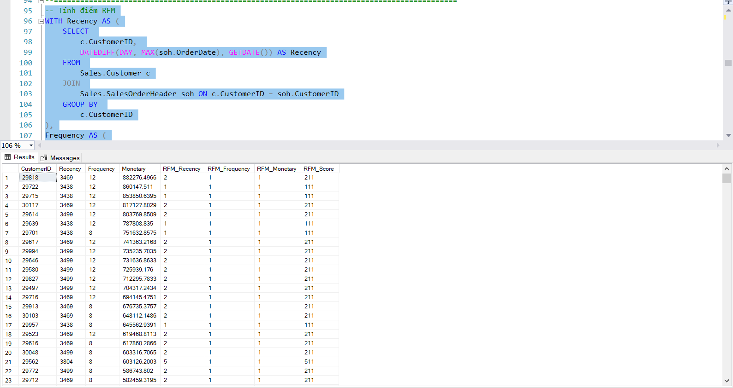
RFM aggregation (is the combination of values in the above 3 queries)
RFM scoring

Slide 19
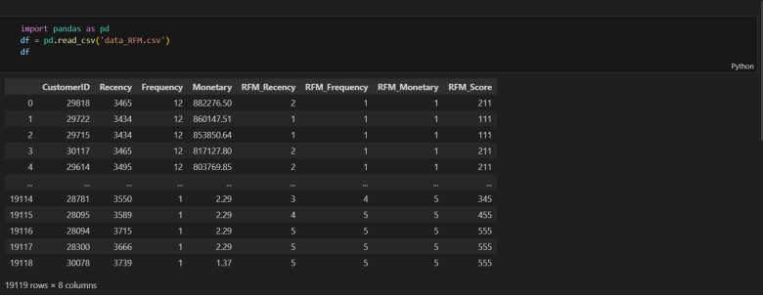
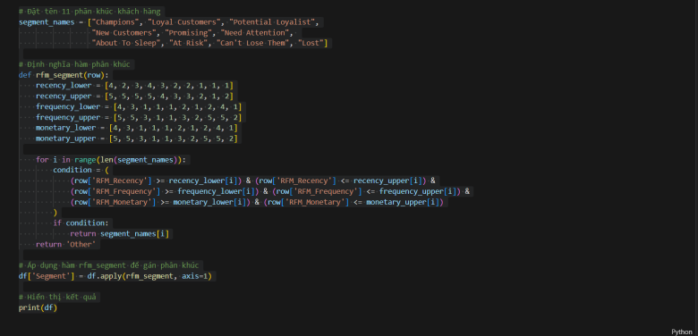
Conduct customer classification
1. import data
2. Conduct classification

Slide 20
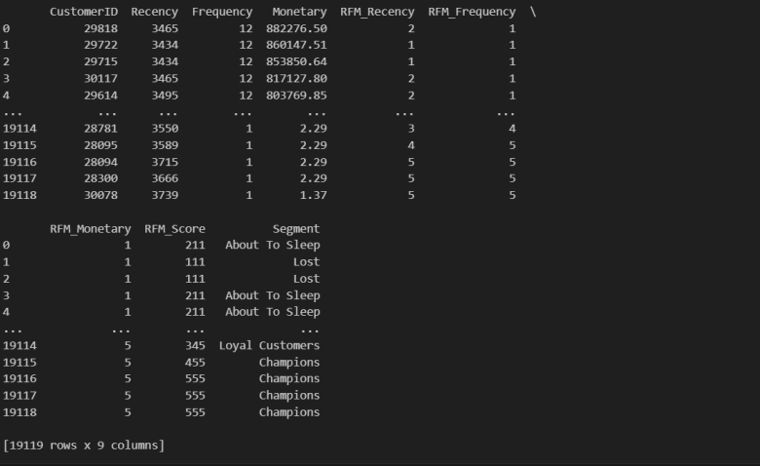

Result

Slide 21
5
Marketing decisions and messages for each customer segment

Slide 22

Customer segment Champion
The "Champion" customer segment is one of the most important customer groups in the marketing strategy. Customers in the "Champion" segment are especially important customers and have the highest level of contribution to the business.
Loyal Customers and Potential Loyalist
The "Loyal Customers" and "Potential Loyalist" segments are both interesting and have the potential to bring long-term benefits to businesses. Maintaining and strengthening relationships with loyal customers will help create brand stability and positioning, while reaching and converting loyal leads will open up opportunities for market expansion and sales growth.

Slide 23

Recent Customers and Promising customer segments
The "Recent Customers" and "Promising" segments are both important in building relationships and growing sales. For new customers, building trust and providing a good experience at an early stage can help establish a loyal customer base.
Customer segmentation: Needing Attention and At Risk
Businesses need to stimulate them to make a transaction as soon as possible, or no awareness of the product/brand will fall into short-term memory and eventually be forgotten by customers
Customer segmentation About To Sleep, Hibernating and Lost
Businesses need to stimulate them to make a transaction as soon as possible, or no awareness of the product/brand will fall into short-term memory and eventually be forgotten by customers

Slide 24


CẢM ƠN THẦY VÀ CÁC BẠN ĐÃ LẮNG NGHE
t

